Slide 1

The K-Anonymity problem
Under the guidance of
Karuna Arava
Asst.Professor
Department of CSE
Project Students:
M.Jawad (14021A0521)
V.Srihari (14021A0518)
R.Yogeshwari (14021A0535)
G.Raghava (14021A0531)

Slide 2
Background
Large amount of person-specific data has been collected in recent years
Both by governments and by private entities
Data and knowledge extracted by data mining techniques represent a key asset to the society
Analyzing trends and patterns.
Formulating public policies
Laws and regulations require that some collected data must be made public
For example, Census data

Slide 3
What About Privacy?
First thought: anonymize the data
How?
Remove “personally identifying information” (PII)
Name, Social Security number, phone number, email, address… what else?
Anything that identifies the person directly
Is this enough?

Slide 4
Re-identification by Linking
Microdata
Voter registration data
ID
Name
Alice
Betty
Charles
David
Emily
Fred
QID |  |  | SA
Zipcode | Age | Sex | Disease
47677 | 29 | F | Ovarian Cancer
47602 | 22 | F | Ovarian Cancer
47678 | 27 | M | Prostate Cancer
47905 | 43 | M | Flu
47909 | 52 | F | Heart Disease
47906 | 47 | M | Heart Disease
Name | Zipcode | Age | Sex
Alice | 47677 | 29 | F
Bob | 47983 | 65 | M
Carol | 47677 | 22 | F
Dan | 47532 | 23 | M
Ellen | 46789 | 43 | F

Slide 5
Quasi-Identifiers
Key attributes
Name, address, phone number - uniquely identifying!
Always removed before release
Quasi-identifiers
(5-digit ZIP code, birth date, gender) uniquely identify 87% of the population in the U.S.
Can be used for linking anonymized dataset with other datasets

Slide 6
Classification of Attributes
Sensitive attributes
Medical records, salaries, etc.
These attributes is what the researchers need, so they are always released directly
Key Attribute
Quasi-identifier
Sensitive attribute
Name | DOB | Gender | Zipcode | Disease
Andre | 1/21/76 | Male | 53715 | Heart Disease
Beth | 4/13/86 | Female | 53715 | Hepatitis
Carol | 2/28/76 | Male | 53703 | Brochitis
Dan | 1/21/76 | Male | 53703 | Broken Arm
Ellen | 4/13/86 | Female | 53706 | Flu
Eric | 2/28/76 | Female | 53706 | Hang Nail

Slide 7
K-Anonymity: Intuition
The information for each person contained in the released table cannot be distinguished from at least k-1 individuals whose information also appears in the release
Example: you try to identify a man in the released table, but the only information you have is his birth date and gender. There are k men in the table with the same birth date and gender.
Any quasi-identifier present in the released table must appear in at least k records

Slide 8

K-Anonymity Protection Model
Private table
Released table: RT
Attributes: A₁, A₂, …, A_{n}
Quasi-identifier subset: A_{i}, …, A_{j}

Slide 9
Generalization
Goal of k-Anonymity
Each record is indistinguishable from at least k-1 other records
These k records form an equivalence class
Generalization: replace quasi-identifiers with less specific, but semantically consistent values
476**
2*
*
47677
47602
47678
29
22
27
Male
Female
ZIP code
Age
Sex

Slide 10
Achieving k-Anonymity
Generalization
Replace specific quasi-identifiers with less specific values until get k identical values
Partition ordered-value domains into intervals
Suppression
When generalization causes too much information loss
This is common with “outliers”

Slide 11
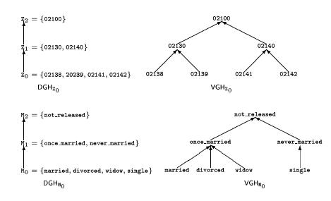
Generalization in Action

Slide 12
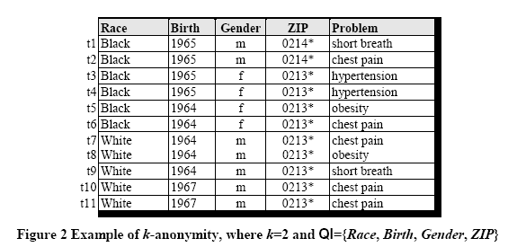
Example of a k-Anonymous Table

Slide 13
Example of Generalization (1)
Released table
External data Source
Name | Birth | Gender | ZIP | Race
Andre | 1964 | m | 02135 | White
Beth | 1964 | f | 55410 | Black
Carol | 1964 | f | 90210 | White
Dan | 1967 | m | 02174 | White
Ellen | 1968 | f | 02237 | White
By linking these 2 tables, you still don’t learn Andre’s problem

Slide 14
Example of Generalization (2)
Microdata
Generalized table
QID |  |  | SA
Zipcode | Age | Sex | Disease
47677 | 29 | F | Ovarian Cancer
47602 | 22 | F | Ovarian Cancer
47678 | 27 | M | Prostate Cancer
47905 | 43 | M | Flu
47909 | 52 | F | Heart Disease
47906 | 47 | M | Heart Disease
QID |  |  | SA
Zipcode | Age | Sex | Disease
476** 476** 476** | 2* 2* 2* | * * * | Ovarian Cancer Ovarian Cancer Prostate Cancer
4790* 4790* 4790* | [43,52] [43,52] [43,52] | * * * | Flu Heart Disease Heart Disease
!!
Released table is 3-anonymous
If the adversary knows Alice’s quasi-identifier (47677, 29, F), he still does not know which of the first 3 records corresponds to Alice’s record

Slide 15
Attacks on k-Anonymity
k-Anonymity does not provide privacy if
Sensitive values in an equivalence class lack diversity
The attacker has background knowledge
A 3-anonymous patient table
Homogeneity attack
Zipcode | Age | Disease
476** | 2* | Heart Disease
476** | 2* | Heart Disease
476** | 2* | Heart Disease
4790* | ≥40 | Flu
4790* | ≥40 | Heart Disease
4790* | ≥40 | Cancer
476** | 3* | Heart Disease
476** | 3* | Cancer
476** | 3* | Cancer
Bob
Zipcode | Age
47678 | 27
Background knowledge attack
Carl
Zipcode | Age
47673 | 36

Slide 16
Our approach towards K-anonymity
To overcome these types of attacks and achieve a good trade off between utility and privacy we came up with the idea of using graph theory to solve this k-anonimity problem with a hueristic algorithm.
The algorithm is scalable for data set with more no.of records or even dimensions.

